Slide 1

From one fricative to another: a perception experiment of coda /s/ and voiced phonemic stops as fricatives in Western Andalusian Spanish
Santiago Arróniz & Erik W. Willis

Slide 2

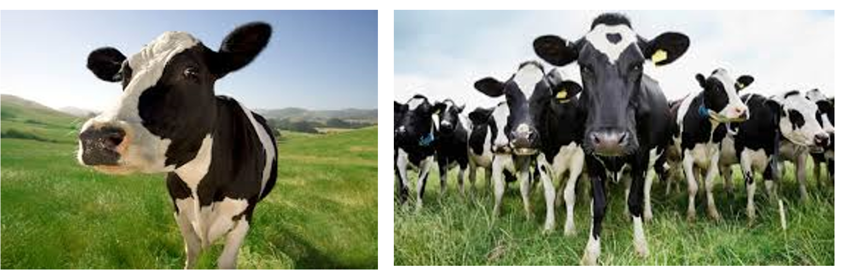
Quick test

Slide 3
Overview the presentation
Review briefly
an overview of /s/ reduction processes in Spanish
an overview of /bdg/ allophony in Spanish
Research questions
Methodology
Results and comparisons of listeners from two dialects
Discussion further research
Conclusions

Slide 4
Debucalization of /-s/ -> [h], [ɦ], [ʔ], [0]
The reduction of /s/ in coda position has been widely reported to occur in many different varieties of Spanish
Specifically, this lenition process has been described to result in
an aspirated variant [1, 2, 3]
a voiced variant [4]
a glottal occlusion [5, 6] or as a
total elision [7], (see also [8] for a complete overview of /s/ variation in Spanish)

Slide 5
Reduction of /-s/ and phonological processes
Recent work on Western Andalusian /s/ + /ptk/ clusters has found that there is an increased VOT on the following stop [9, 10, 11] (inter alia)
Eastern Andalusian Spanish has been shown to lengthen and lower the preceding vowel among other phenomena [12, 13, 14]

Slide 6
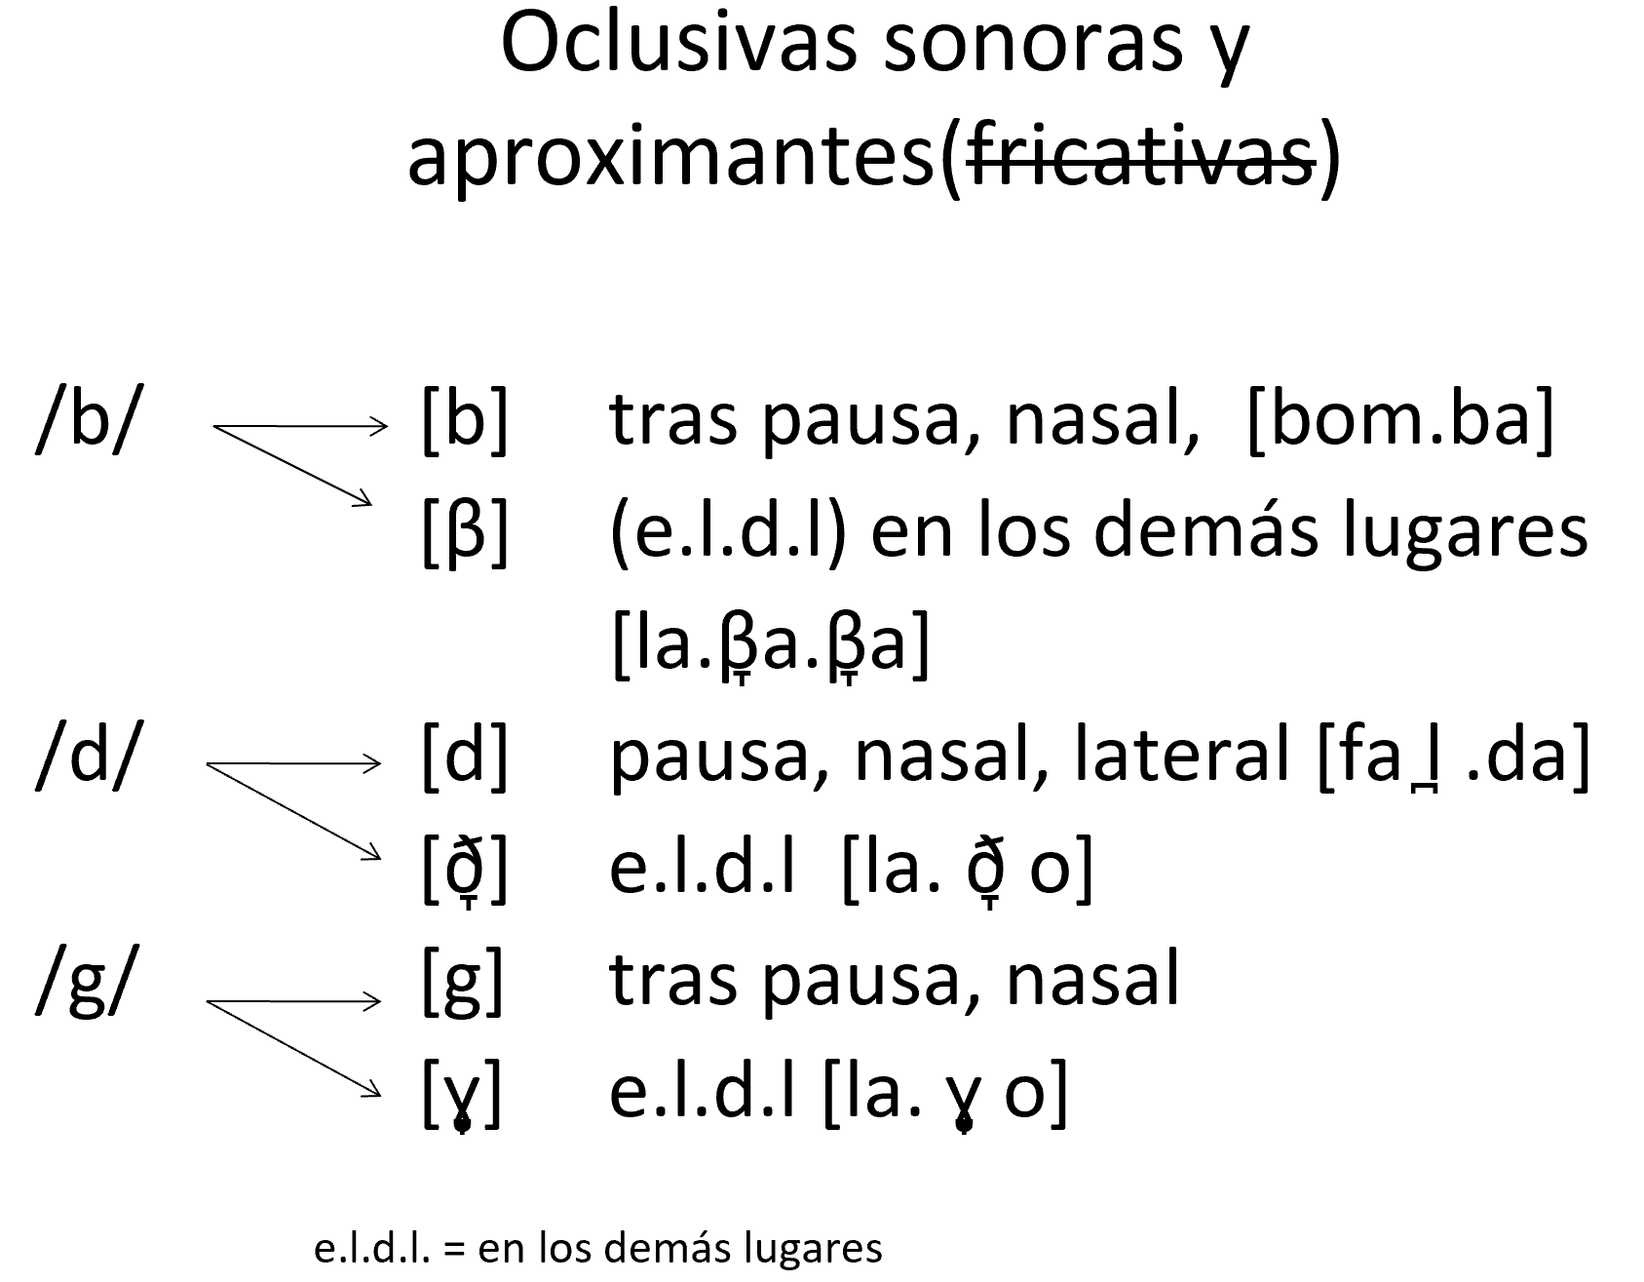
Spirantization or reduction of /b d g/
Traditional research of Spanish describes spirantization in terms of two distinct allophones in complementary distribution [15]
The stop allophones [b d g] are found after pause, after a nasal, and, in the case of /d/, also after a lateral
While the approximant allophones [β̞ ð̞ ɣ̞] are found elsewhere [16]

Slide 7
Puerto Rican /s/ + /bdg/ [17]
Coda /s/ + /bdg/
Coda /s/ is often elided before a /bdg/
Following an elided /s/ the /bdg/ is produced with
Greater occlusion intensity ratio
Greater segment duration
[β̞] was produced with /V__V/ contexts
[b] was produced with /s_V/ contexts

Slide 8
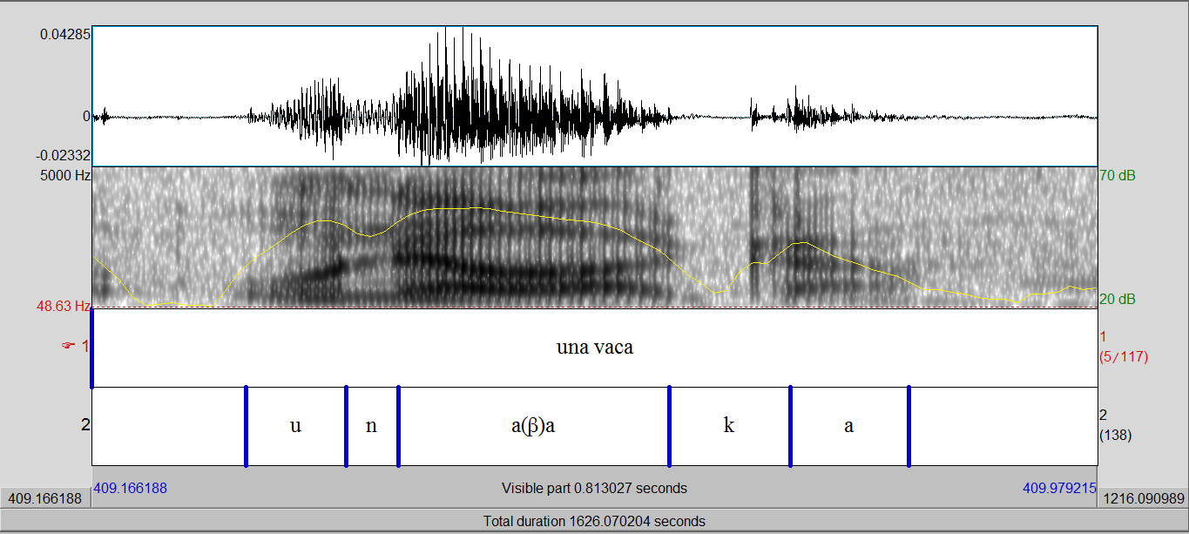

Puerto Rico: "una vaca" [17]

Slide 9
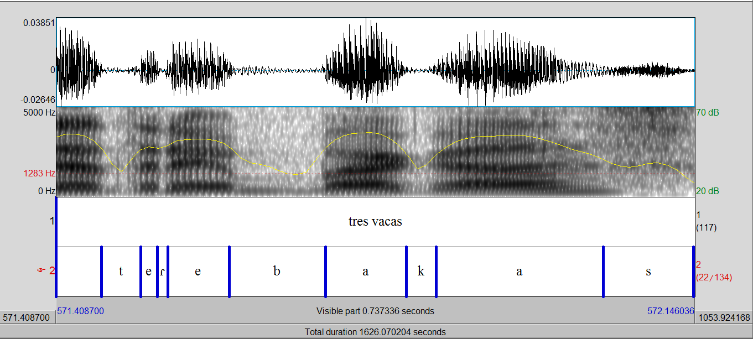
Puerto Rico: "tres vacas" [17]

Slide 10
Motivation for the current study
We were replicating the Puerto Rican contexts for a comparative perception task
We observed a novel allophony of fricative variants (previously described in production studies, )
We will refer to these Andalusian sounds as a Compenstated Voiced Fricative (CVF)
We decided to test if these phones were perceptually phonemic or contrastive, and to whom
A singular versus plural context provides a comparative minimal pair context for comparison

Slide 11
In this paper, we test the perceptual categorization of this compensation process by creating minimal pairs of the type /u.na.bo.ta/ -> [u.na.β̞o.ta] - versus /u.nas.bo.tas/ -> [u.na.'vo.ta]
We hypothesize that if the singleton fricative realizations ([v], [ð] or [ɣ]) are associated with plurality, we have evidence for a novel contrastive phone resulting from /s/ reduction and spirantization as a new compensatory strategy

Slide 12
Singular versus plural-approximant versus voiced fricative
[u.na.β̞a.ka]
[u.na.va.ka]

Slide 13
Research questions
Do Andalusians associate a voiced fricative [ v ð ɣ ] with the heterosyllabic cluster /s/ + /bdg/ to recognize a plural item?
Do Mexican listeners associate a voiced fricative [ v ð ɣ ] with the heterosyllablic cluster /s/ + /bdg/ to recognize a plural item?
How confident are Andalusians and Mexicans as they evaluate the novel allophones as markers of /-s/ + voiced stops?

Slide 14
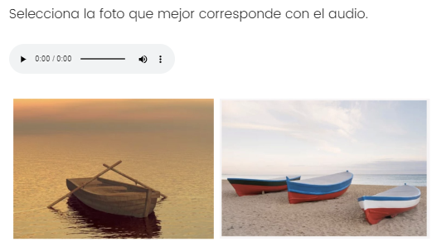
Task 1: Forced choice picture selection
Heat map forced choice
Listener clicks the audio and then selects the appropriate picture
Forced choice allows for a binary characterization

Slide 15
Task 2: Visual analog slider task
Visual analog slider task [21]
Identifies categories
Captures “confidence” in the ratingsof the categories
100% singular - 0 - 100% plural

Slide 16
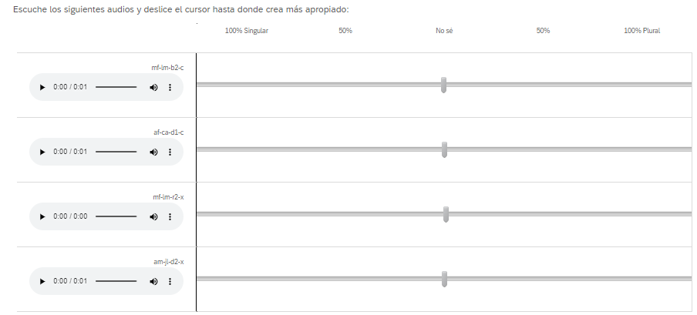
Visual analog slider task
-100 value represented 100% Singular
+100 value represented 100% Plural
0 reflected no preference or ‘don’t know’
Stimuli

Slide 17
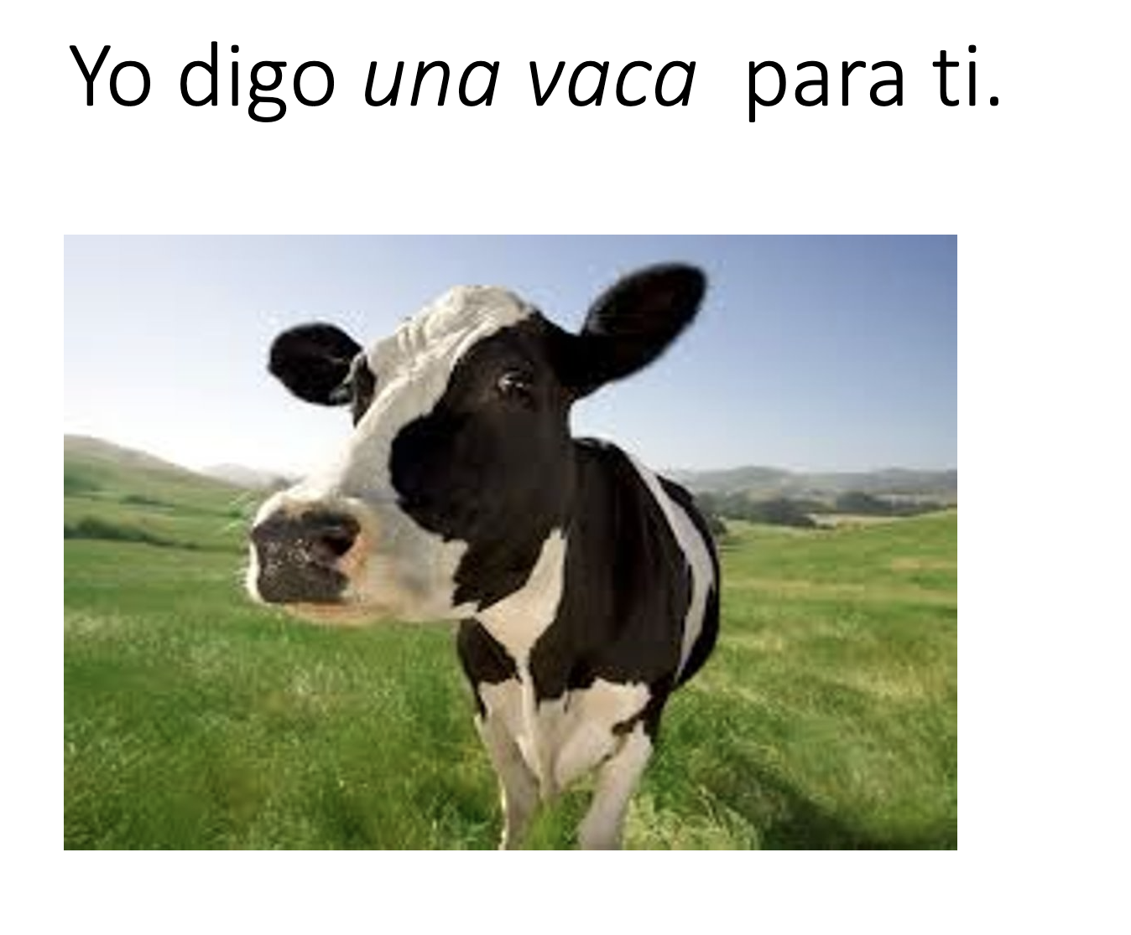
Method: Actors/speakers
Four native speakers from Andalusia (2 male and 2 female, 25-30 years of age)
Two native speakers from Mexico (25 and 50 years of age)
Tokens extracted from a carrier phrase based on a picture
Lab recordings
Audios were normalized in terms of volume

Slide 18
Method: Andalusian tokens and distractors
Target tokens pairs include an indefinite article 'una/unas' + ten target words with word initial /bdg/
The singular tokens were produced with an approximant allophone
[u.na] + [ β̞ ð̞ ɣ̞ ]
The plural tokens were produced with a fricative allophone
[u.na] + [ v ð ɣ ]
This comparison created minimal pairs based on an approximant or fricative realization of the phonemic /bdg/
Each plural audio was reviewed to make sure there was no [s] or [h] as aspiration in the actor production

Slide 19
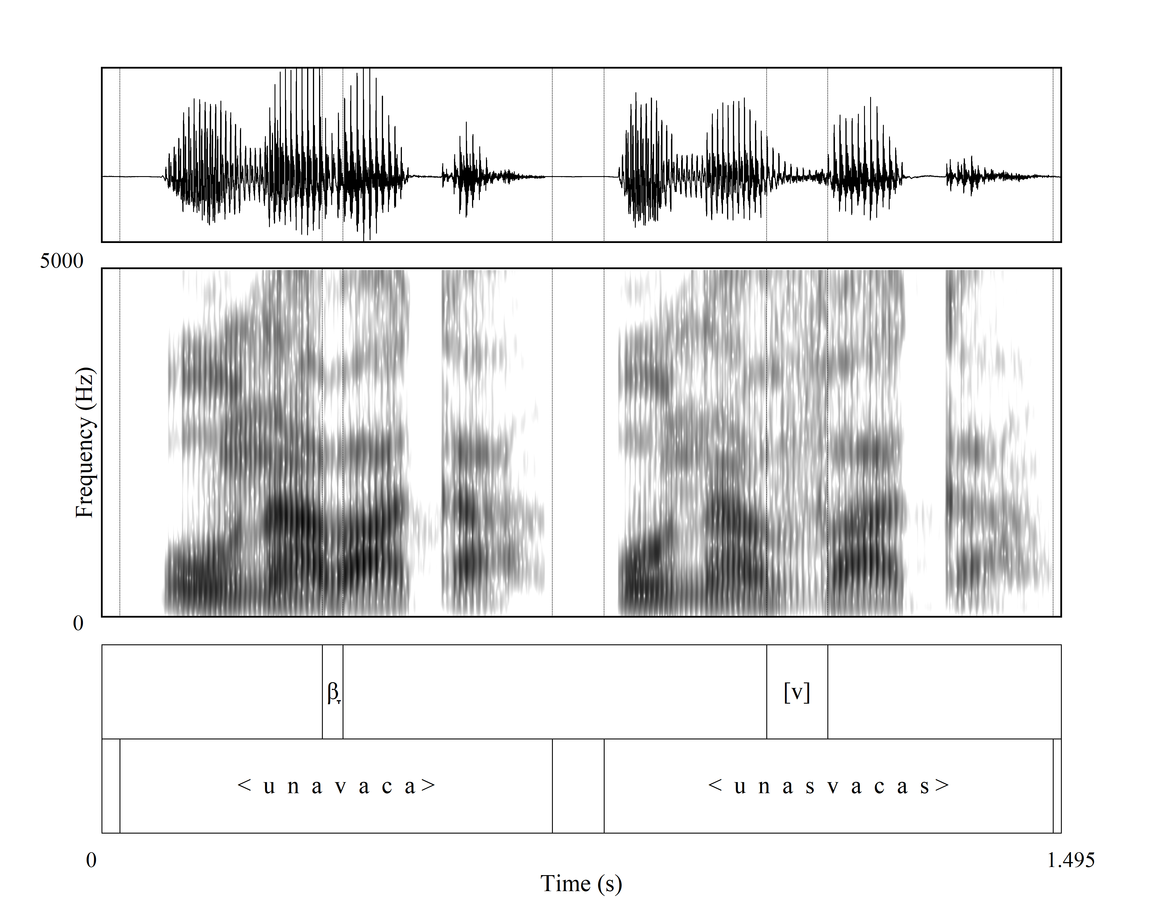

Sample productions

Slide 20
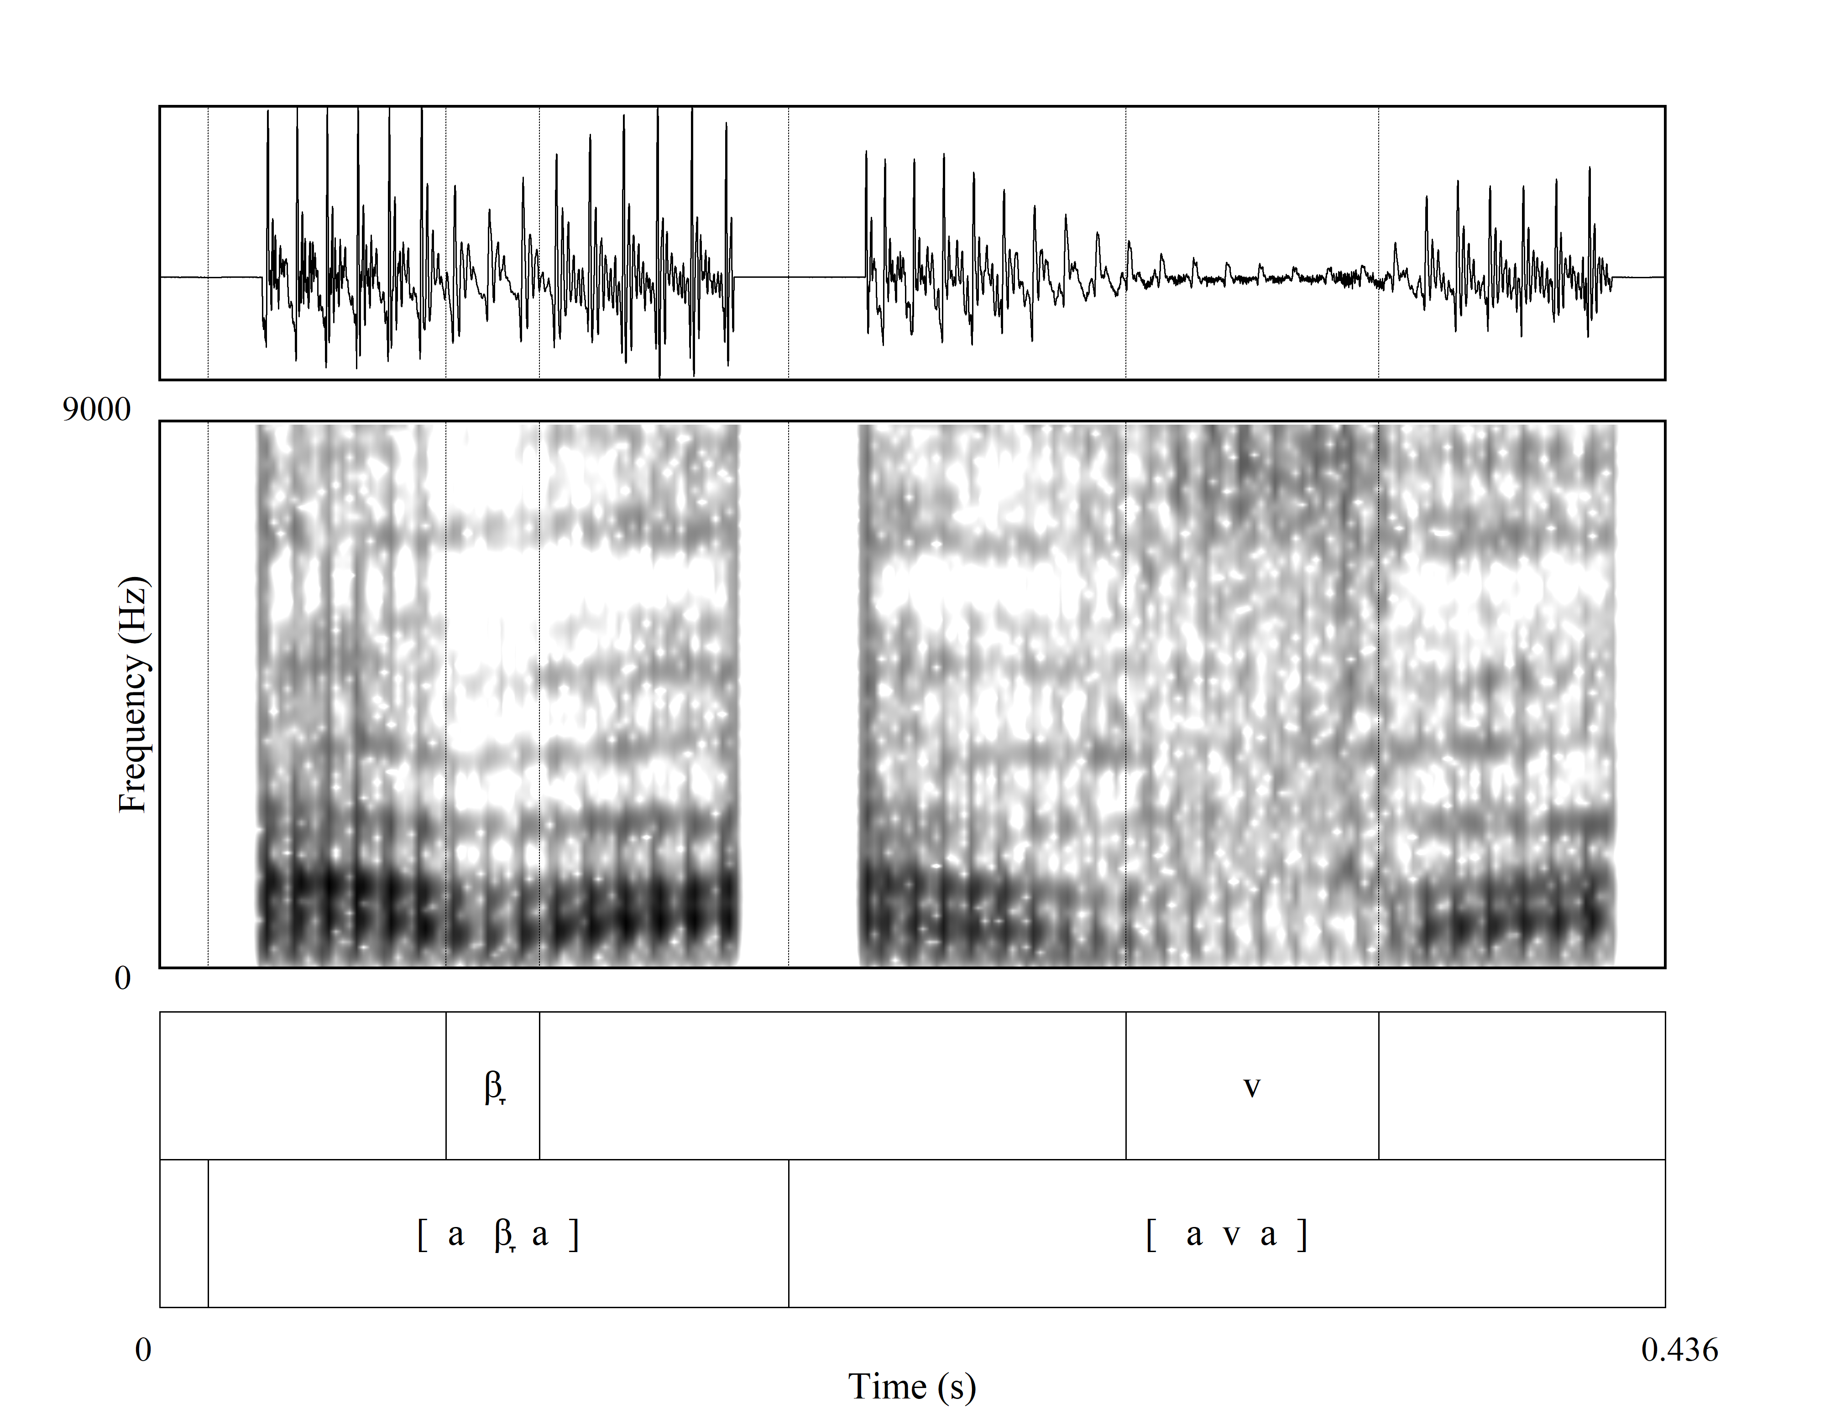

Sample productions

Slide 21
Method: Mexican tokens and distractors
Target tokens an indefinite article 'una/unas' + six target words with word initial /bdg/
The singular tokens were produced with an approximant allophone
[u.na] + [ β̞ ð̞ ɣ̞ ]
The plural tokens were produced with a fricative [s] the target voiced stop
[u.nas] + [ β̞ ð̞ ɣ̞ ]
The inclusion of Mexican speech was to confirm that listeners were able to hear a plural /s/ and associate it with plurality and to compare the evaluations with Andalusian productions

Slide 22
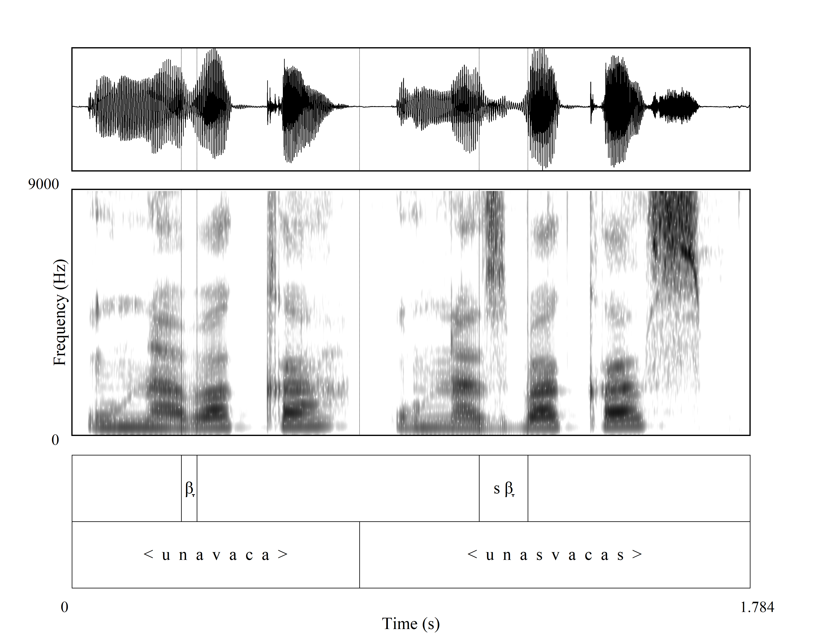

Sample productions: Mexican

Slide 23
Method: Token distribution
The Andalusian speakers were divided into two groups to allow each sex to produce each phoneme type without producing both singular and plural prompts
Each listener heard two singular and plural pair of tokens from each phoneme
Mexican speakers likewise were heard only producing a singular or plural prompt
There were fewer Mexican tokens as it was assumed that the productions with [s] would be heard as plural near categorically (which they were)

Slide 24
Method: Participants and Evaluations
Andalusians (32 listeners)
Mexicans (37 listeners)
Task 1
AND evaluations N= 256 (8x1x32)
MEX evaluation N= 296 (8x1x37)
Task 2
AND evaluations N= 512 (4x4x32)
MEX evaluation N= 592 (4x4x37)
Total evaluations N = 1,656

Slide 25
Method: Survey Distribution
The Qualtrics survey [22] was sent to targeted populations in Seville and Mexico City area (university faculty and students)
Informants were provided with a brief training and asked to use headphones if possible and adjust the volume to a comfortable level
A background questionnaire was also included at the end of the survey including information regarding age, sex, and community demographics

Slide 26
Results Task 1 – Forced choice picture identification
We show sample evaluations for approximant and fricative productions for [β̞] vs [v] for Mexico and Andalusia
A comparison of Andalusian plural audios by dialect listeners

Slide 27
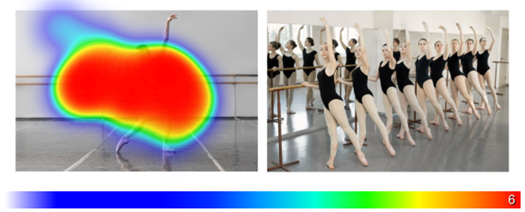
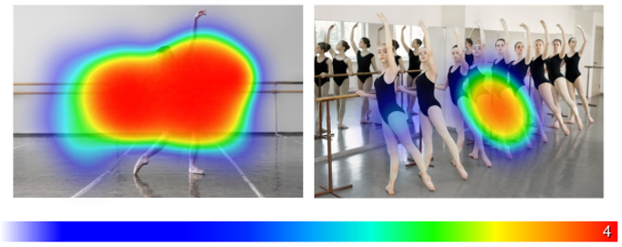

Sample Mexican listeners - [β̞] vs [v]
Approximant [β̞] in [u.na.β̞ai̯.la.ɾi.na]
Fricative [v] in [u.na.vai̯.la.ɾi.na]

Slide 28
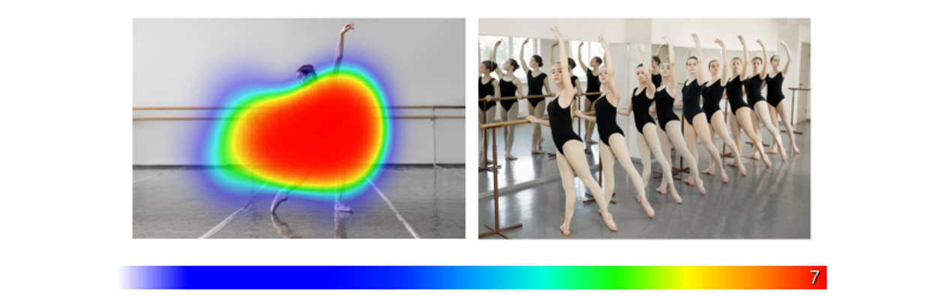
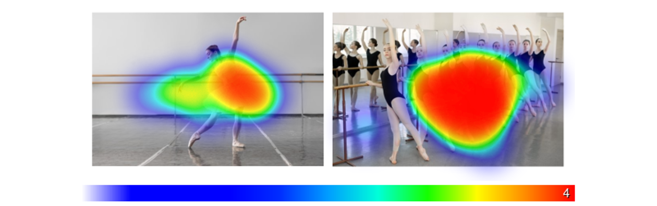
Sample Andalusian listeners - [β̞] vs [v]
Approximant [β̞] in [u.na.β̞ai̯.la.ɾi.na]
Fricative [v] in [u.na.vai̯.la.ɾi.na]

Slide 29
Plural tokens for both listeners - [v]
Fricative [v] - [u.na.vai̯.la.ɾi.na]

Slide 30
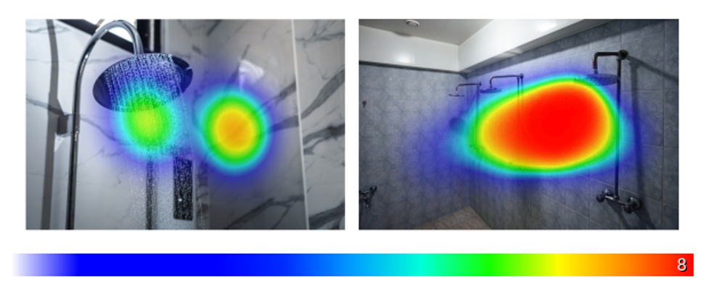
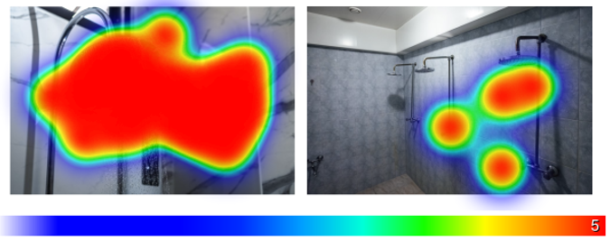
Plural tokens for both listeners - [ð]
Fricative [ð] in [u.na.ðu.tʃa]

Slide 31
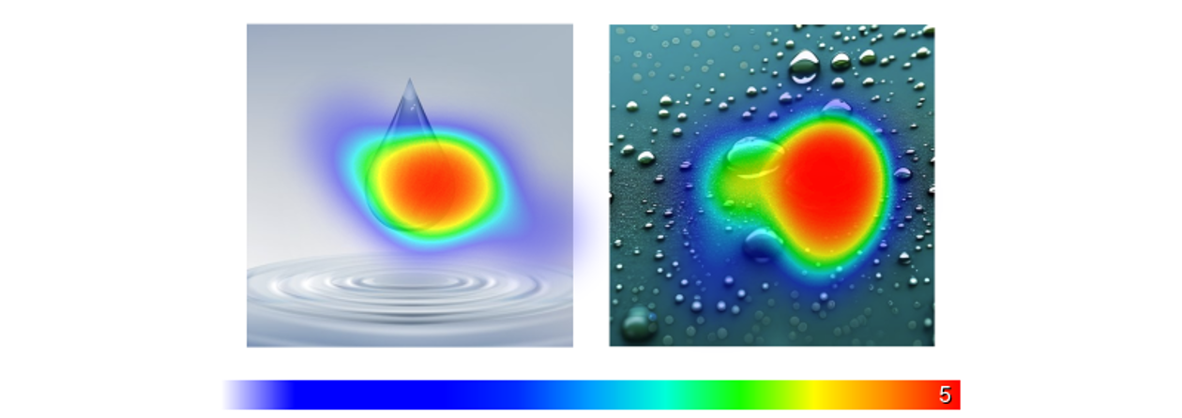
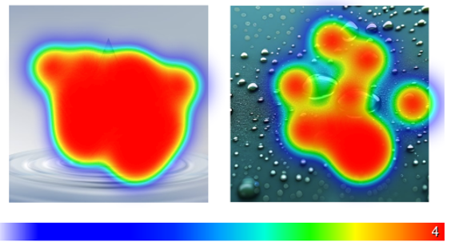
Plural tokens for both listeners - [ɣ]
o [ɣ̥]
Fricative [ɣ] in [u.na.ɣo.ta]
o [u.na.ɣ̥o.ta]

Slide 32
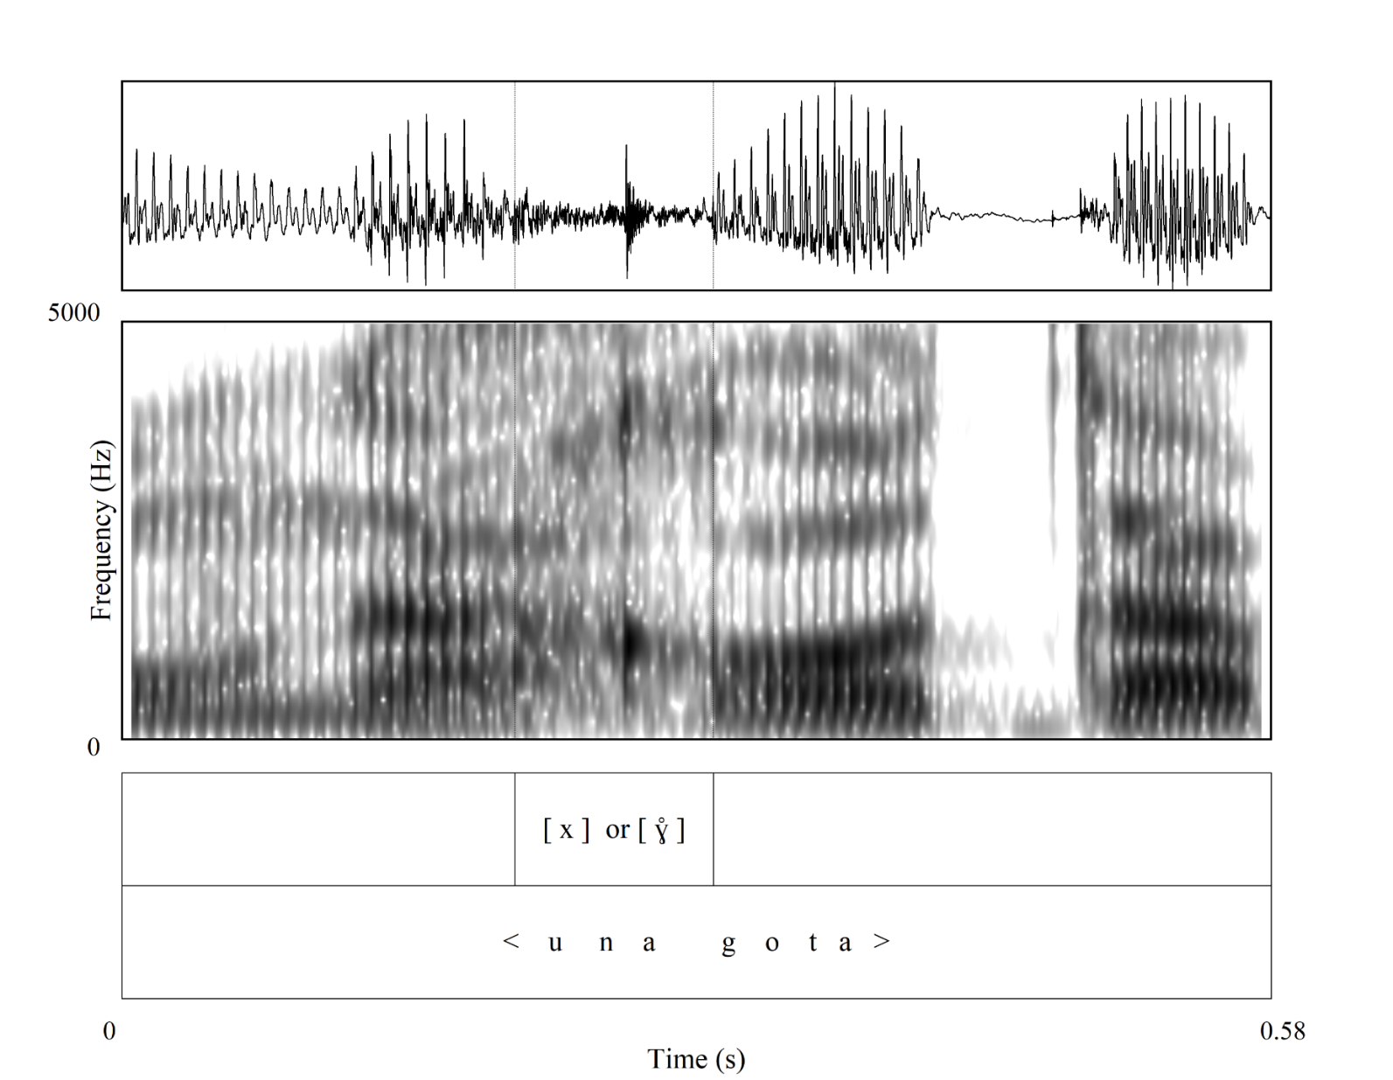
Andalusian velar plural

Slide 33
Results Task 2 – Visual analog slider
We show the evaluations by:
Mexico
Perception of SINGULAR tokens from both dialects
Perception of PLURAL tokens from both dialects
Segment /bdg/
Andalusia
Perception of SINGULAR tokens from both dialects
Perception of PLURAL tokens from both dialects
Segment /bdg/

Slide 34
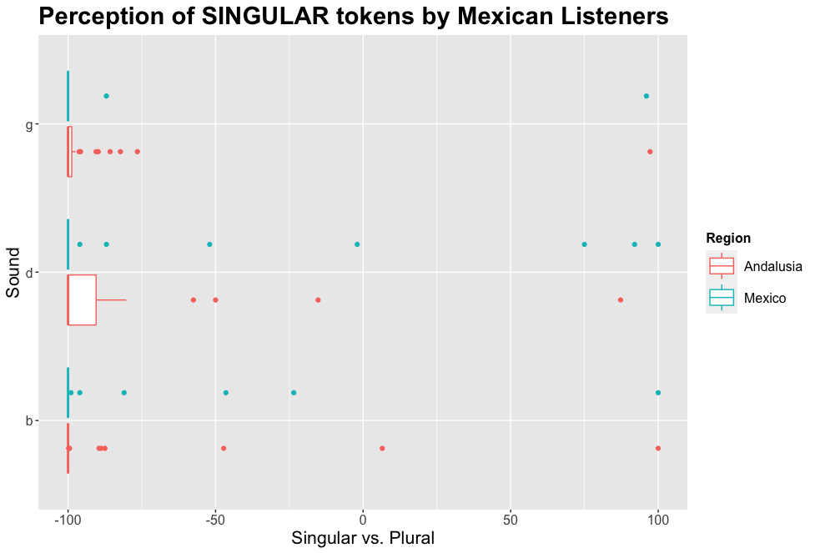

Task 2: Visual analog slider
[ β̞ ð̞ ɣ̞ ]
[ β̞ ð̞ ɣ̞ ]

Slide 35
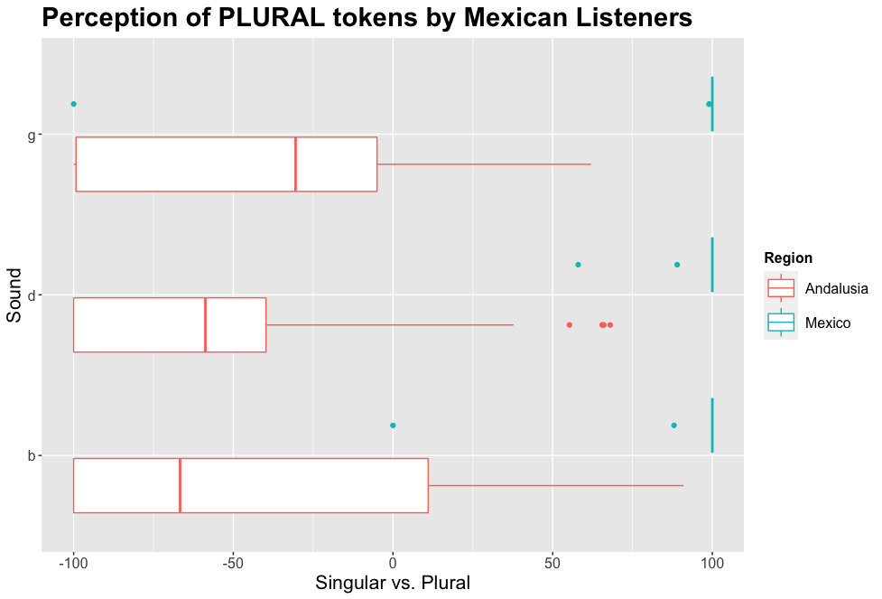
Task 2: Visual analog slider
[ v ð ɣ ]
[s] + [ β̞ ð̞ ɣ̞ ]

Slide 36
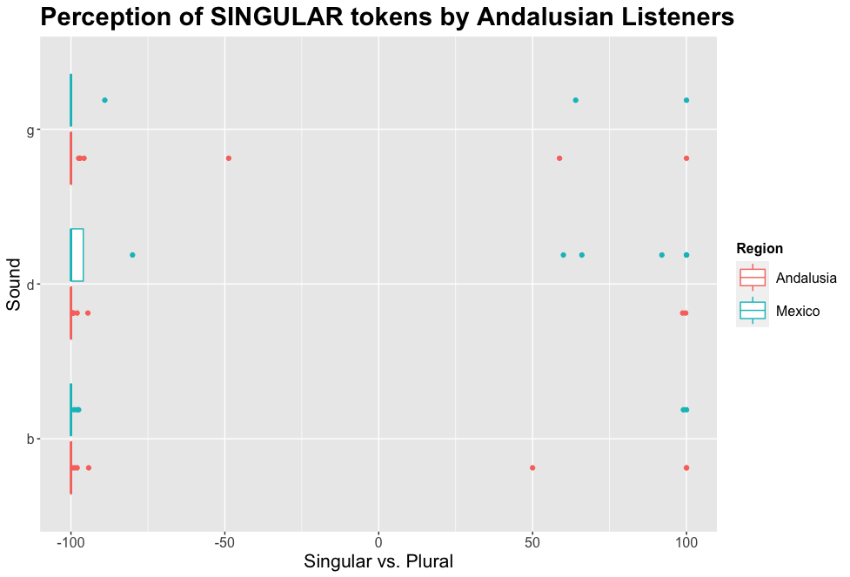
Task 2: Visual analog slider
[ β̞ ð̞ ɣ̞ ]
[ β̞ ð̞ ɣ̞ ]

Slide 37
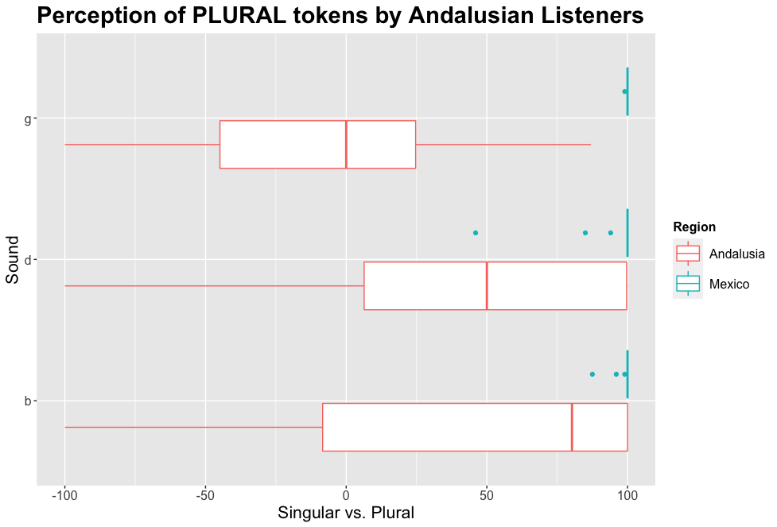
Task 2: Visual analog slider
[ v ð ɣ ]
[s] + [ β̞ ð̞ ɣ̞ ]

Slide 38
Discussion: Research questions
Do Andalusians associate a voiced fricative [ v ð ɣ ] with the heterosyllabic cluster /s/ + /bdg/ to recognize a plural item?
Do Mexican listeners associate a voiced fricative [ v ð ɣ ] with the heterosyllablic cluster /s/ + /bdg/ to recognize a plural item?
How confident are Andalusians and Mexicans as they evaluate the novel allophones as markers of /-s/ + voiced stops?
YES
NO
VARIABLY

Slide 39
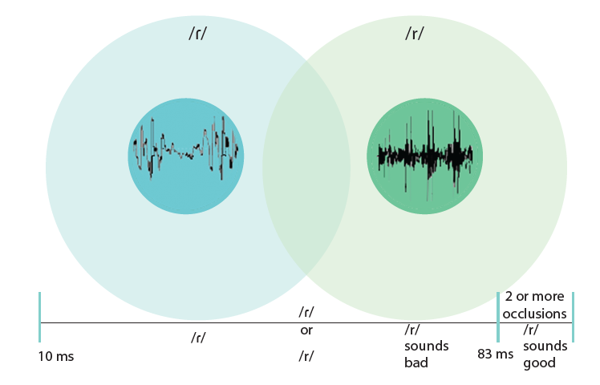
Discussion: Segmental contrast maintenance
Melero and Cisneros (2020)
Spanish phonological taps and trills with a single closure
Single closures (taps) with a closure duration < 50 ms are perceived as a phonemic tap
Single closures (taps) with a closure duration > 50 ms are perceived as a phonemic trill
Contrast is maintained by the amount of closure duration

Slide 40
Discussion: contrast through compensation processes of multiple phonemes
Compensatory lengthening is a well-known compensatory process in English
/hæt/ -> [hæ ̚ ] versus /hæd/ -> [hæː ̚ ]
Coda liquid reduction and voiced stop gemmination is documented in Cuba
/seɾ.be.sa/ -> [se.b:e.sa]
Andalusian voiceless stop aspiration from a previous /s/ can also be viewed as a compensatory process
/pa.ta/ -> [pa.ta] versus /pas.ta/ -> [pa.t^{h}a]
New finding: Andalusian /s/ + voiced stop as fricative phonemes

Slide 41


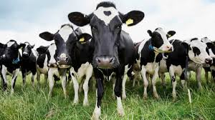


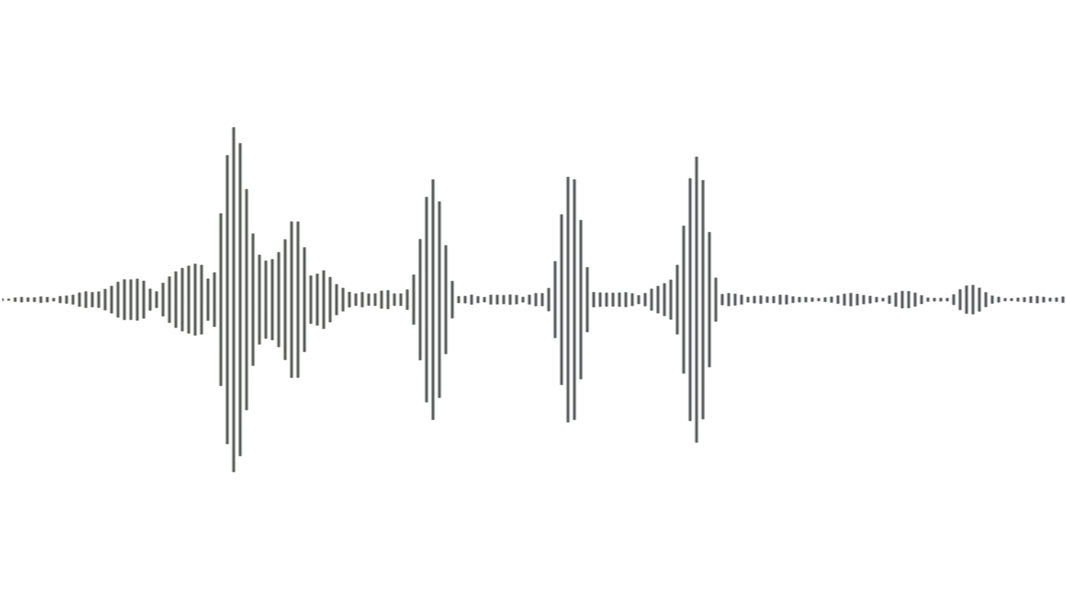
[v] = /sb/
[ u. n a. v a. k a ]
[v] = /sb/
Andalusian
Andalusian

Slide 42

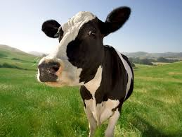

[v] = /sb/
[ u. n a. v a. k a ]
[v] = /b/
Andalusian
Mexican

Slide 43
Discussion: Opaque versus transparent compensation processes
We often discuss the how of sound change
Lenition processes
Articulatory in gestural (re-)timing
Gemmination
Nasalization
Devoicing
Fortition
Our goal was to explore the result of a phonological process similar to claims of neutralization
This fricativization process results in a phonemic contrast for Andalusian listeners, while it is neutralized or non contrastive for Mexican listeners

Slide 44




Transparency versus opacity of the phonological process
~
The fricative productions are an opaque process for Mexican listeners yielding a single interpretation—singular or no /-s/

Slide 45


Transparency versus opacity of the phonological process
[ β̞ ]
[ v ]
The fricative productions are contrastive and transparent for Andalusian listeners resulting in a /-s/ + /bdg/ interpretation

Slide 46
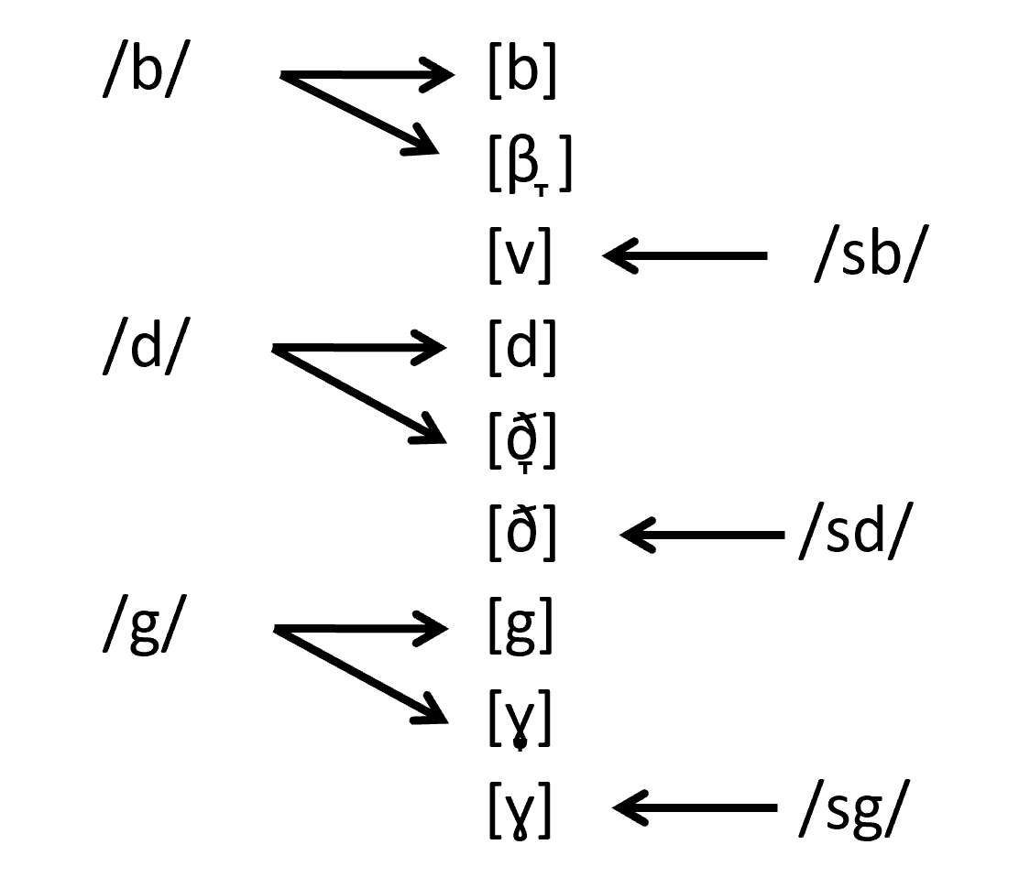
Two-way segment allophony and two-way contrast
/bdg/ /s/ + /bdg/

Slide 47
Next steps
Production study investigating:
Closure intensity
Closure duration
Voicing
Dialectal contact
Geographical distribution of phenomena
Perception follow-up
All the above plus...
Evaluations of language attitudes for each of the fricative phonemes

Slide 48
Conclusions
Andalusians associate a voiced fricative [ v ð ɣ ] with the heterosyllabic cluster /s/ + /bdg/ to recognize a plural item – a transparent process
A voiced fricative [ v ð ɣ ] was opaque and not recognized as a phonemic heterosyllabic cluster /s/ + /bdg/ by Mexican listeners
Andalusians are generally confident in their interpretation of the plural fricative, with some variability based on voicing
Mexicans are reasonably confident, though inaccurately, as they evaluate the novel fricative allophones as markers of /-s/ + voiced stops

Slide 49
Acknowledgements
Our actors
Friends and colleagues who shared the Qualtrics
Spanish Phonetics Working Group at Indiana University

Slide 50
References
1. Bybee J. Lexicalization of sound change and alternating environments. In: Broe M, Pierrehumbert J, editors. Papers in Laboratory Phonology 5: Acquisition and the lexicon. Cambridge: Cambridge University Press; 2000. p. 250-268.
2. Hualde JI. The Sounds of Spanish. New York: Cambridge University Press; 2005.
3. Lipski JM. On the weakening of /s/ in Latin American Spanish. Zeitschrift für Dialektologie und Linguistik. 1984;31-43.
4. Willis EW, Delgado-Díaz G, Galarza I. Contextualized Voicing of the Voiceless Posterior Fricative /h/ in Puerto Rican Spanish. In: Butragueño PM, Willis EW, Herrera Zendejas E, editors. Laboratory Approaches to Romance Phonology. Mexico City, Mexico: Cascadilla Proceedings Project; 2015. p. 52-69.
5. Luna K. The Spanish of Ponce, Puerto Rico: A phonetic, phonological, and intonational analysis. Ph.D. Dissertation, University of California, Los Angeles; 2010.
6. Valentín-Márquez W. La Oclusión Glotal y la Construcción Lingüística de Identidades Sociales en Puerto Rico. In: Sagarra N, Toribio J, editors. Selected Proceedings of the 9th Hispanic Linguistics Symposium. Somerville, MA: Cascadilla Proceedings Project; 2006. p. 326-341.
7. Poplack S. The notion of plural in Puerto Rican Spanish: competing constraints on (s) deletion. In: Labov W, editor. Locating Language in Time and Space. New York: Academic Press; 1980. p. 55-67
8. Núñez-Méndez E. Variation in Spanish /s/: Overview and New Perspectives. Languages. 2022;7:77.
9. Torreira F. Coarticulation between Aspirated-s and Voiceless Stops in Spanish: An Interdialectal Comparison. Selected Proceedings of the 9th Hispanic Linguistics Symposium. 2006.
10. Torreira F. Pre- and postaspirated stops in Andalusian Spanish. Segmental and Prosodic Issues in Romance Phonology. 2007:67-82.
11. Ruch H, Peters S. On the origin of post-aspirated stops: Production and perception of/s/+ voiceless stop sequences in Andalusian Spanish. Laboratory Phonology. 2016;7:1-36.

Slide 51
References continued
12. Hualde J, Sanders B. A New Hypothesis on the Origin of the Eastern Andalusian Vowel System. Annual Meeting of the Berkeley Linguistics Society. 2014;21.
13. de Haro AH, Hajek J. Eastern Andalusian Spanish. Journal of the International Phonetic Association. 2022;52:135-56.
14. Henriksen N. Patterns of vowel laxing and harmony in Iberian Spanish: Data from production and perception. Journal of Phonetics. 2017;63:106-26.
15. Navarro Tomás T. Manual de pronunciación española. 19th ed. Madrid: Consejo Superior de Investigaciones Científicas; 1977.
16. Martínez Celdrán E. Sobre la naturaleza fonética de los alófonos de/b, d, g/en español y sus distintas denominaciones. 1991.
17. Galarza I, Delgado-Díaz G, Willis E. ¿Nuevamente/s/? Una nueva mirada a la elisión de /s/ implosiva en el español de Puerto Rico. In: 7th Workshop on Spanish Sociolinguistics, Madison, WI. 2014.
18. Romero Gallego J. Gestural organization in Spanish: An experimental study of spirantization and aspiration. Ph.D. Dissertation, University of Connecticut; 1995.
19. Fernández RJ. El andaluz. Arco Libros; 1999.
20. Del Saz M. Effects of place of articulation on Spanish coda /s/ perception. In: Nebot AC, editor. Perspectivas actuales en el análisis fónico del habla. Tradición y avances en la fonética experimenta. Universitat de València: Universitat de València; 2015.
21. Kapnoula EC, Winn MB, Kong EJ, Edwards J, McMurray B. Evaluating the sources and functions of gradiency in phoneme categorization: An individual differences approach. J Exp Psychol Hum Percept Perform. 2017;43:1594-611.
22. Qualtrics. Provo, Utah, United States of America; 2023.

Slide 52
¡Muchas gracias!
[ˈmu.tʃa.ˈɣɾa.θi̯aʰ]
sarroniz@indiana.edu ewwillis@indiana.edu

